Slide 1


Bank of Baroda Hackathon - 2022
Technology Partner
Your Team Name : Ctrl Alt Elite
Your team bio : We are bunch of data scientists with a straightforward vision, passion, and great potential
Date : 1/09/2022

Slide 2
Problem Statement?
Why did you decide to solve this Problem statement?
Considering that call centers are second most important after company’s actual service/product, it is vital to focus on agent performance, turnaround time, privacy, analytics and explore various techniques for enhancing services while reducing call volume. Which means it is expected to ensure that every call center meets the required criteria for performance, services, and customer satisfaction.

Slide 3
User Segment & Pain Points
Which user /advertiser segment would be early adopter of your product & why?
Bank of Baroda Management’s Pain Points
Agent activity insights
Dashboard with various aspects
Real time analytic with existing digital channel
Customer’s Pain Points
Delay in resolution time
Leakage in PII (Personal Identifiable Information)
Repetitive conversation

Slide 4
Pre-Requisite
What are the alternatives/competitive products for the problem you are solving?
Ameyo
Teckinfo
Deepcall
Calabrio

Slide 5
Azure tools or resources
Azure tools or resources which are likely to be used by you for the prototype, if your idea gets selected Azure Cognitive Services Azure Api Management Azure Blockchain Azure Synapse Analytics Azure Web Apps Power Platforms on Azure

Slide 6
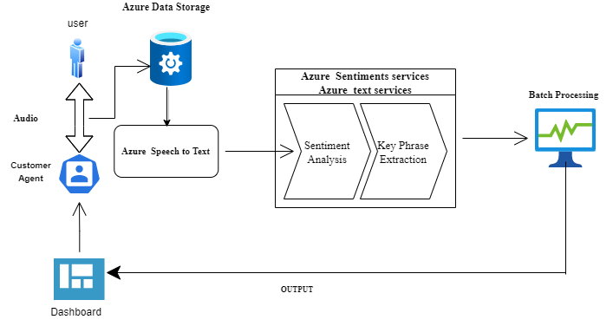
Any Supporting Functional Documents
Present your solution, talk about methodology, architecture & scalability

Slide 7
Key Differentiators & Adoption Plan
How is your solution better than alternatives and how do you plan to build adoption?
Key Differentiators
Supports combination of multiple regional languages.
Quick turnaround time by leveraging technology.
Real Time Monitoring.
Representation of Dashboard.
Adoption Plan
A. PLAN
Prepare your organization to support user adoption
B. MANAGE
Build acceptance through communication, training and feedback loops
C. SUSTAIN
Establish metrics, monitor performance and create a culture open to change

Slide 8
Thank You
SHIVAM MEHTA AARYA URANKAR ASHISH SINGH SHIVANI SHREE

